Slide 1
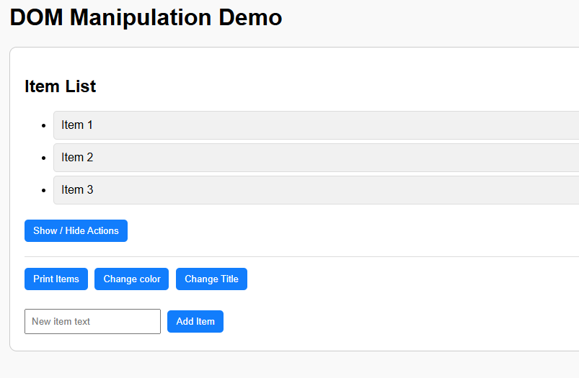
WEB DESIGN
W10 – DOM Manipulation

Slide 2

What will you learn today?
Understand what is the DOM
Select DOM elements (as example using the ID of the element)
Change DOM element properties (as example the text content)
Change DOM element styles (as example the visibility, color)
Handle DOM events (as example a click on button)
Get DOM input value
Create a new DOM element

Slide 3
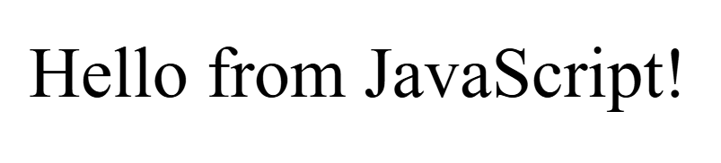
EXPLAIN
The power of JavaScript with HTML
JavaScript can be used on HTML pages to update HTML elements dynamically
<html>
<body>
<p id="text">Hello.</p>
<script>
const paragraph = document.getElementById("text");
paragraph.textContent = "Hello from JavaScript!";
</script>
</body>
</html>
1 - Get the HTML element of id ‘’text”
2 - Change its value dynamically
3 - UI is automatically updated
Notes:
You can make a parallel with canvas to explain the root notion and the methods.
Document = the whole web page ⬄ Canvas = the drawing screen

Slide 4
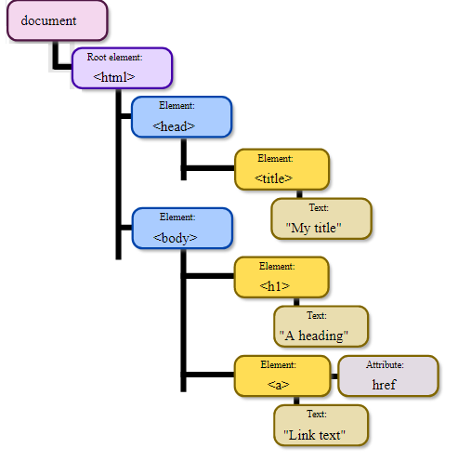

EXPLAIN
What is the DOM?
The DOM (Document Object Model) is a tree structure of an HTML page where each node is an object representing a part of this page
The document is the root element of the DOM tree
Elements can have
properties
The browser creates the DOM to render the page.
Elements can have
children
Notes:
You can make a parallel with canvas to explain the root notion and the methods.
Document = the whole web page ⬄ Canvas = the drawing screen

Slide 5
EXPLAIN
What can we do with the DOM ?
MORE INFOS
DOM API
- Update elements attributes
- Update elements style
- Remove elements
Add elements
Listen to elements Events
And much more...
JS
DOM
Using JS, you can manipulate DOM elements
! But DOM is not part of the JS
Browser uses the DOM API to interact with DOM

Slide 6
EXPLAIN
DOM API - Access to elements
var element = document.getElementById(ID) | Get the element that matches with ID
document.getElementsByClassName(CLASS) | Get all elements that match with the CLASS
document.querySelectorAll(QUERY) | Get all elements that match the QUERY
element.children[INDEX] | Get the child of given INDEX of the current element
element.parentNode | Get the parent node of given element
Notes:
!!!!!!!!!!!!!!!!!!!
If you really want to explain querySelectorAll, take the time to explain how queries are made (Using CSS tags etc…)

Slide 7
EXPLAIN
DOM API - Change elements attributes
element.textContent = “hello” | Get / Set the text of an element
element.className = “container” | Get / Set the class of an element
element.style.display = node | hide an element
element.style.display = block | show an element
element.style.backgroundColor = "red"; | Change an element style

Slide 8
EXPLAIN
DOM API - Add/remove elements
document.createElement(type) | Create a new element of the given type Type (string) : any valid tag name for HTML , SVG elements html, div, span, p, h1, h2, ul, ol, li, Table, form, input, textarea etc.
element.appendChild(newElement) | Add an element to the current element
element.remove() | Remove the current element
parentElement.remove(childElement) | Remove the given child element from the parent

Slide 9
EXPLAIN
An example to understand !
<div id=“container"> <p id=“text1">This is a paragraph</p> <p id=“text2">This is another paragraph</p> </div>
<script>
const newP = document.createElement("p");
newP.id = 'text3';
newP.textContent = "New paragraph";
const domContainer = document.getElementById("container");
domContainer.appendChild(newP);
</script>
We create a new element of type paragraph
We set the node textContent
We get the DIV container , using getElementByID
We append the new paragraph to the container DIV
<div id=“container"> <p id=“text1">This is a paragraph</p> <p id=“text2">This is another paragraph</p>
<p id=“text3">New paragraph</p> </div>
As a result, a new paragraph is added to the DIV container

Slide 10
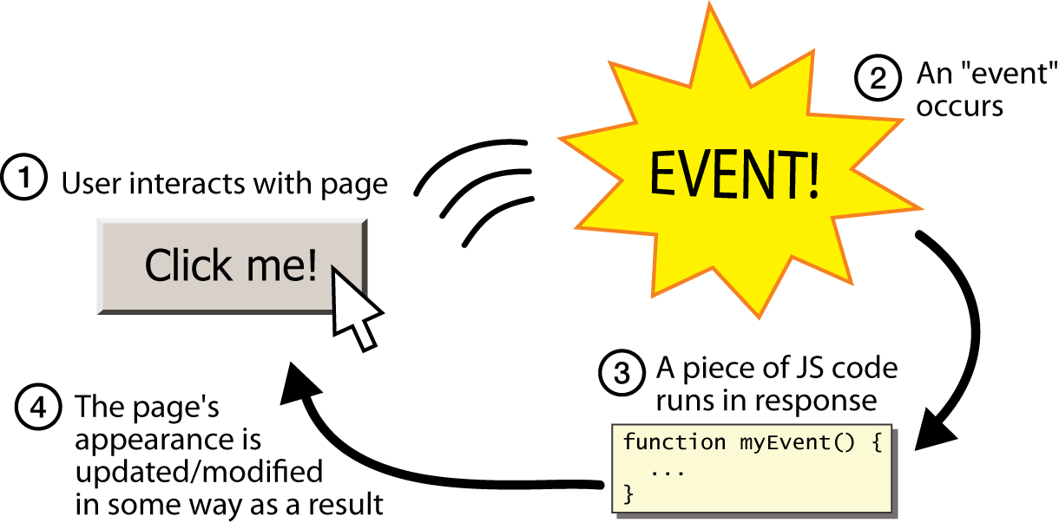
EXPLAIN
DOM API - Listen to an event

Slide 11
EXPLAIN
DOM API - Listen to an event
element.addEventListener(name,function) | Register an Event Handler, for the event name to the element, and the function to execute when the event happens.
element.removeEventListener(name,function) | Remove the Event Handler function for the event name from the element.

Slide 12
EXPLAIN
DOM API - Get Event information
event.target | a reference to the object related to the event
event.clientX | The X coordinate at which the event occured
event.clientY | The Y coordinate at which the event occured

Slide 13
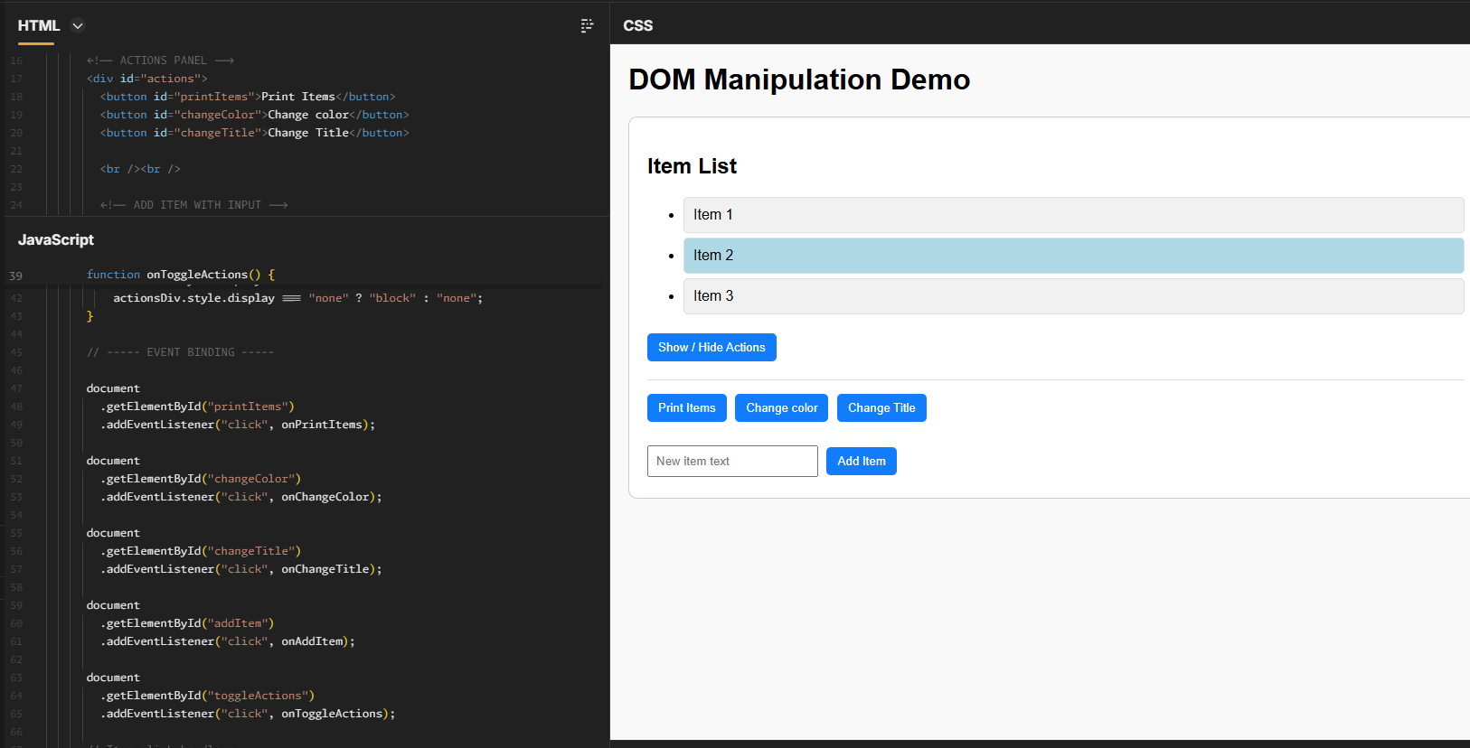
DEMO
Let’s explore !
Open the DEMO-CODE
Take some time to explore the code for each actions
ACTIONS EXPLORE
Print the list on console
Show / Hide an element
Change the color of an item
Change the title
Add an item

Slide 14
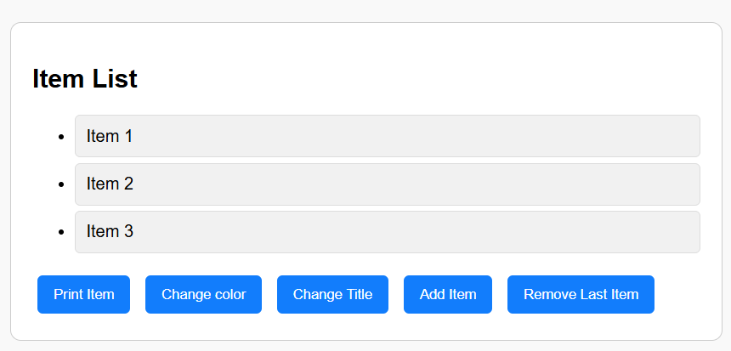
DEMO
Case 1
When clicking the “Print Item" button, the list of items is displayed on console
Item 1
Item 2
Item 3

Slide 15
EXPLAIN
Display items lists upon button click
1 - select the button from the DOM, using the ID
const printButton = document.getElementById("printItems");
printButton.addEventListener("click", onPrintItems);
function onPrintItems() {
const list = document.getElementById("itemList");
const items = list.children;
for (const item of items) {
console.log(item.textContent);
}
}

Slide 16
EXPLAIN
Display items lists upon button click
const printButton = document.getElementById("printItems");
printButton.addEventListener("click", onPrintItems);
function onPrintItems() {
const list = document.getElementById("itemList");
const items = list.children;
for (const item of items) {
console.log(item.textContent);
}
}
2 - Tell the browser “When this button is clicked, run this function:

Slide 17
EXPLAIN
Display items lists upon button click
const printButton = document.getElementById("printItems");
printButton.addEventListener("click", onPrintItems);
function onPrintItems() {
const list = document.getElementById("itemList");
const items = list.children;
for (const item of items) {
console.log(item.textContent);
}
}
3 - onPrintItems runs only when the click happens

Slide 18
EXPLAIN
Display items lists upon button click
const printButton = document.getElementById("printItems");
printButton.addEventListener("click", onPrintItems);
function onPrintItems() {
const list = document.getElementById("itemList");
const items = list.children;
for (const item of items) {
console.log(item.textContent);
}
}
4 - We access the <ul> element containing the items.

Slide 19
EXPLAIN
Display items lists upon button click
const printButton = document.getElementById("printItems");
printButton.addEventListener("click", onPrintItems);
function onPrintItems() {
const list = document.getElementById("itemList");
const items = list.children;
for (const item of items) {
console.log(item.textContent);
}
}
5 - children gives us all <li> elements inside the list.

Slide 20
EXPLAIN
Display items lists upon button click
const printButton = document.getElementById("printItems");
printButton.addEventListener("click", onPrintItems);
function onPrintItems() {
const list = document.getElementById("itemList");
const items = list.children;
for (const item of items) {
console.log(item.textContent);
}
}
6 We print the LI
Text content

Slide 21
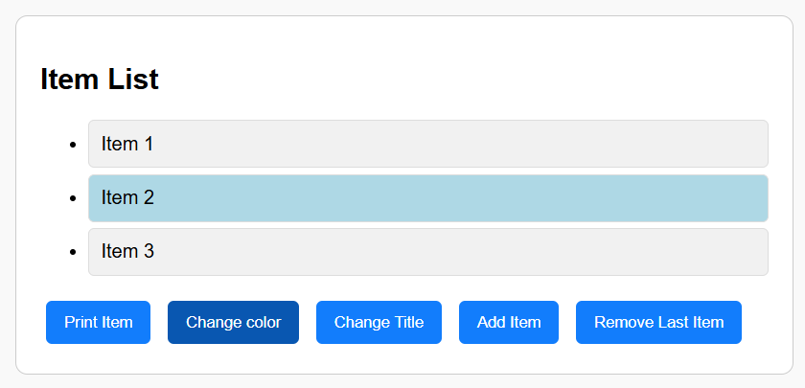
DEMO
Case 2
When clicking the "Change color" button, Change the background color of the second <li> to light blue

Slide 22
EXPLAIN
Change a color upon click
2 - Tell the browser “When this button is clicked, run this function:
1 - select the button from the DOM, using the ID
const changeColorButton = document.getElementById("changeColor");
changeColorButton.addEventListener("click", onChangeColor);
function onChangeColor() {
const list = document.getElementById("itemList");
const secondItem = list.children[1];
secondItem.style.backgroundColor = "lightblue";
}
Select the list and get the 2nd element
style is an object representing inline CSS.
Changing a property immediately updates the UI.

Slide 23
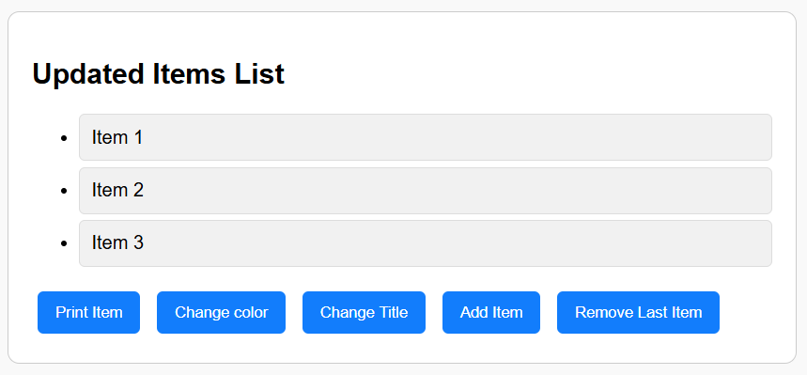
DEMO
Case 3
When clicking the "Change title" button, change the text of the <h2> to "Updated Items List".

Slide 24
EXPLAIN
Change a text upon click
Get the title form the element ID in HTML
function onChangeTitle() {
const title = document.getElementById("containerTitle");
title.textContent = "Updated Items List";
}
Change the element text

Slide 25
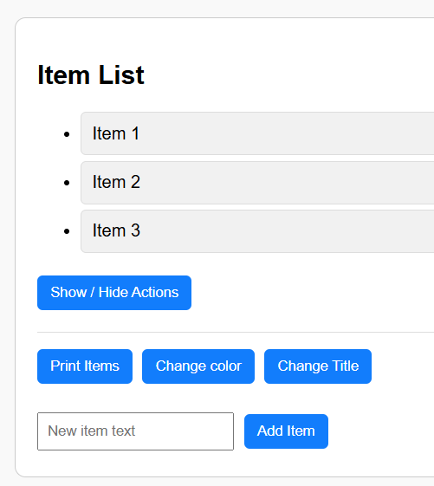
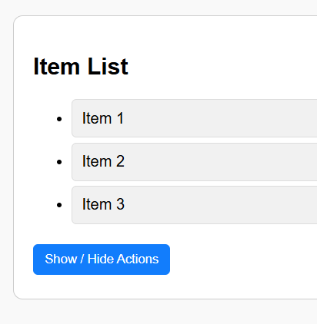
DEMO
Case 4
When clicking the “Show/Hide" button, the DIV containing the actions button is displayed / hidden

Slide 26
EXPLAIN
Show / Hide
function show(element) {
element.style.display = "block";
}
function hide(element) {
element.style.display = "none";
}
function isVisible(element) {
return element.style.display !== "none";
}
function onToggleActions() {
const actionsDiv =
document.getElementById("actions");
if (isVisible(actionsDiv)) {
hide(actionsDiv);
} else {
show(actionsDiv);
}
}
Let s first create 3 small reusable functions
To make the code more readable
Now the action is jus
To get the DOM element can make it visible / invisible

Slide 27
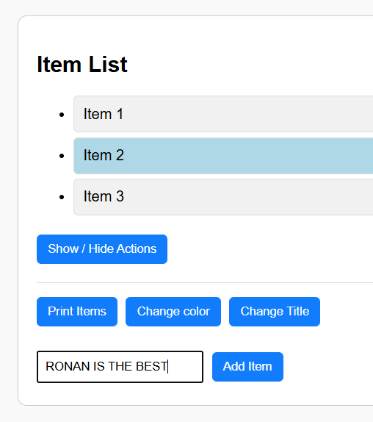
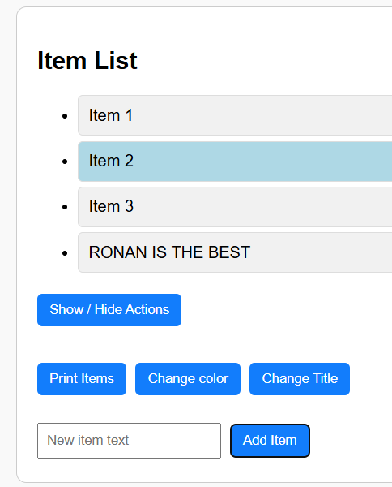
DEMO
Case 5
When clicking the "Add Item" button, append a new <li> element with the text entered in the input.

Slide 28
EXPLAIN
Add a new item
Select the <input> element using its id.
function onAddItem() {
const input = document.getElementById("newItemText");
const text = input.value;
if (text === "") return;
const li = document.createElement("li");
li.className = "item";
li.textContent = text;
document.getElementById("itemList").appendChild(li);
input.value = "";
}
Use .value to get the text the user typed
Create a new DOM element LI
Clear the input field
Append the new item to the list

Slide 29
WHAT WE HAVE LEARNT
Understand what is the DOM
Select DOM elements (as example using the ID of the element)
Change DOM element properties (as example the text content)
Change DOM element styles (as example the visibility, color)
Handle DOM events (as example a click on button)
Get DOM input value
Create a new DOM element

Slide 30
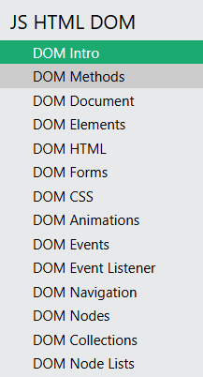
HOMEWORK
AFTER THIS SESSION
1 – Read the following chapter on W3School:
https://www.w3schools.com/js/js_htmldom.asp
2 - You can also watch the following videos
https://www.youtube.com/watch?v=NO5kUNxGIu0
https://www.youtube.com/watch?v=FQtjI1PC5Z0
https://www.youtube.com/watch?v=RKXIMnSwUcg
https://www.youtube.com/watch?v=WCRi7y6aNrQ
https://www.youtube.com/watch?v=g_vXSKbfUiQ
What you need to learn

